Slide 1



INFO1112 Tutorial
Week 13

Slide 2
Week 13, how to prepare?

Slide 3



Gather all learning materials
Lectures
https://github.com/SolSaviour/INFO1112-Materials
Tutorial Sheets
Tutorial Power Points

Slide 4
Make sure you understand
Use the learning resources to write notes for yourself on each week’s content, focus on anything you do not understand!
Attempt to tackle any tutorial questions you may not have finished during the tutorial
Ask questions on Edstem for clarifications on relevant topics
Revisit any homework questions you did not finish
Use outside resources to fill in any gaps in understanding

Slide 5
Test Yourself
Revisit the Mid-semester Quiz
Use Lecture 12’s Practice Quiz section

Slide 6
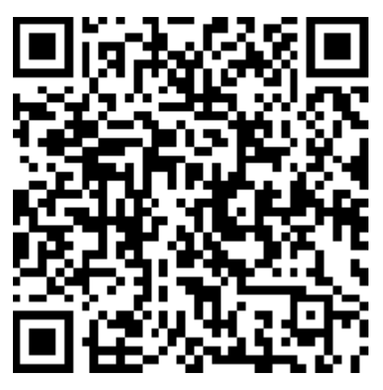
Attendance
https://bit.ly/3KwhJMG

